Slide 1
Orders - State-Quantity and Profit
File created on: 1/28/2022 11:02:19 PM

Slide 2


Slide 3
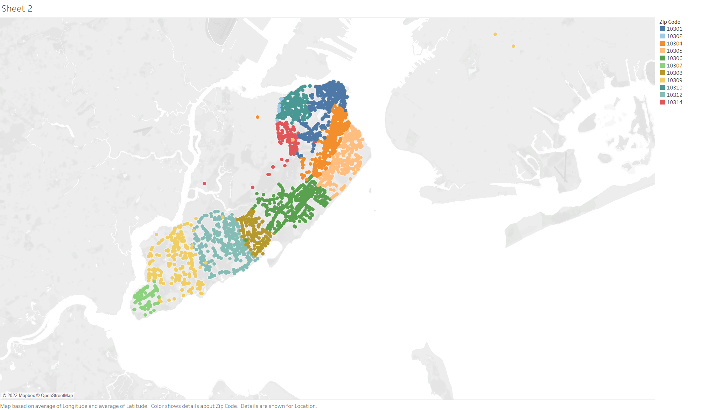

Slide 4
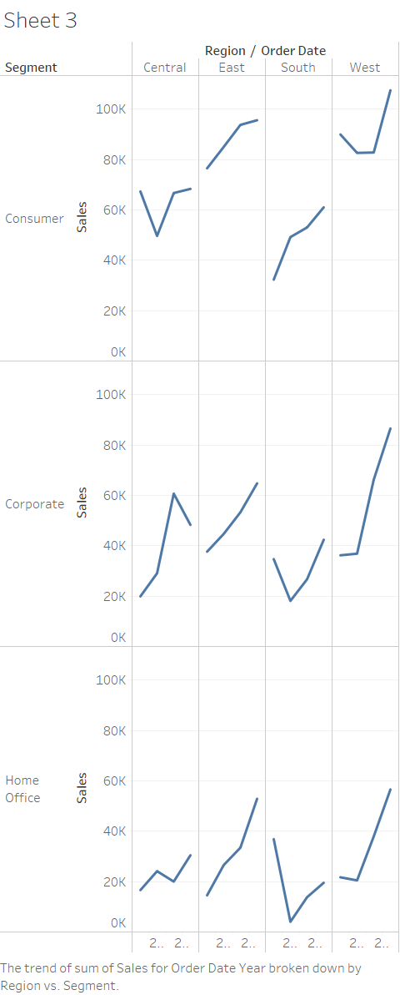

Slide 5


Slide 6
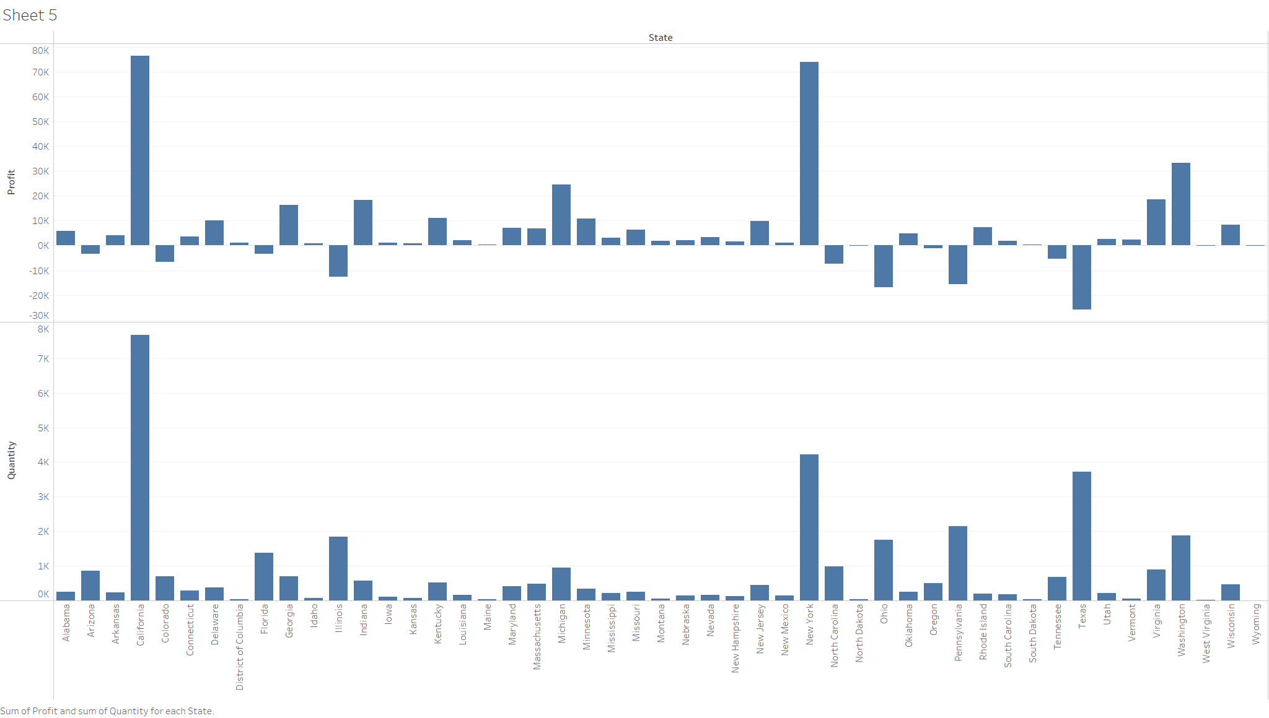

Slide 7
